Slide 1




In situ CO₂-based evaluation of the CMS flux product
(and S. American Inversions)
PI: John Miller, U. Colorado/NOAA
Collaborators: Kevin Bowman, Junjie Liu, JPL
Also: Caroline Alden (Stanford), Sourish Basu (NOAA)

Slide 2
Objectives
Use calibrated (in situ) measurements of CO2 from NOAA to evaluate JPL/CMS data assimilation system.
Use measurements of Amazonian CO2 from light aircraft to help fill in GOSAT/ACOS data gaps above a critical region.
Dry season valid retrievals (ACOS 2.?)
Notes:
Today, just focus on objective 1. Mention significance of calibrated and in situ.

Slide 3
Differences in Observed and Simulated N-S gradients of CO2

Slide 4
Differences in Observed and Simulated N-S gradients of CO2

Slide 5
Differences in Observed and Simulated N-S gradients of CO2

Slide 6
Differences in Observed and Simulated N-S gradients of CO2

Slide 7
Differences in Observed and Simulated N-S gradients of CO2

Slide 8
Differences in Observed and Simulated N-S gradients of CO2

Slide 9
Differences in Seasonal Cycles of CO2

Slide 10
Differences in Seasonal Cycles of CO2

Slide 11
Differences in Seasonal Cycles of CO2

Slide 12
Differences in Vertical Profiles of CO2

Slide 13
Differences in Vertical Profiles of CO2

Slide 14
South American Regional Inversions

Slide 15
Amazonian C flux has been woefully underconstrained
The “Residual dumping ground” of global inversions
-- Prof. Denning
Gurney et al., 2002, Nature
J. Ometto et al., 2005, Oecologia
S. American estimates vary wildly…not so for the temperate north,especially in the last ~ 5 years (more obs).

Slide 16
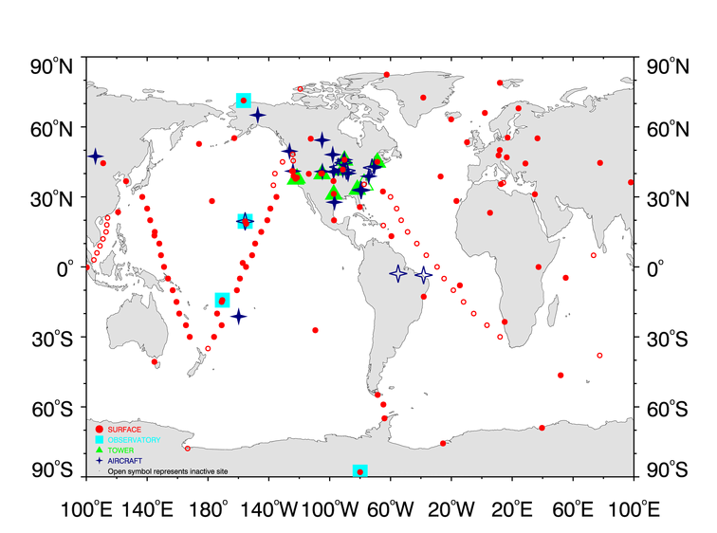
Amazonian C flux has been woefully underconstrained…because we don’t have enough observations (in the right places)
Notes:
Upwind and downwind sites are reasonable in the mid and high lats. Not in the tropics where convection is very significant.

Slide 17
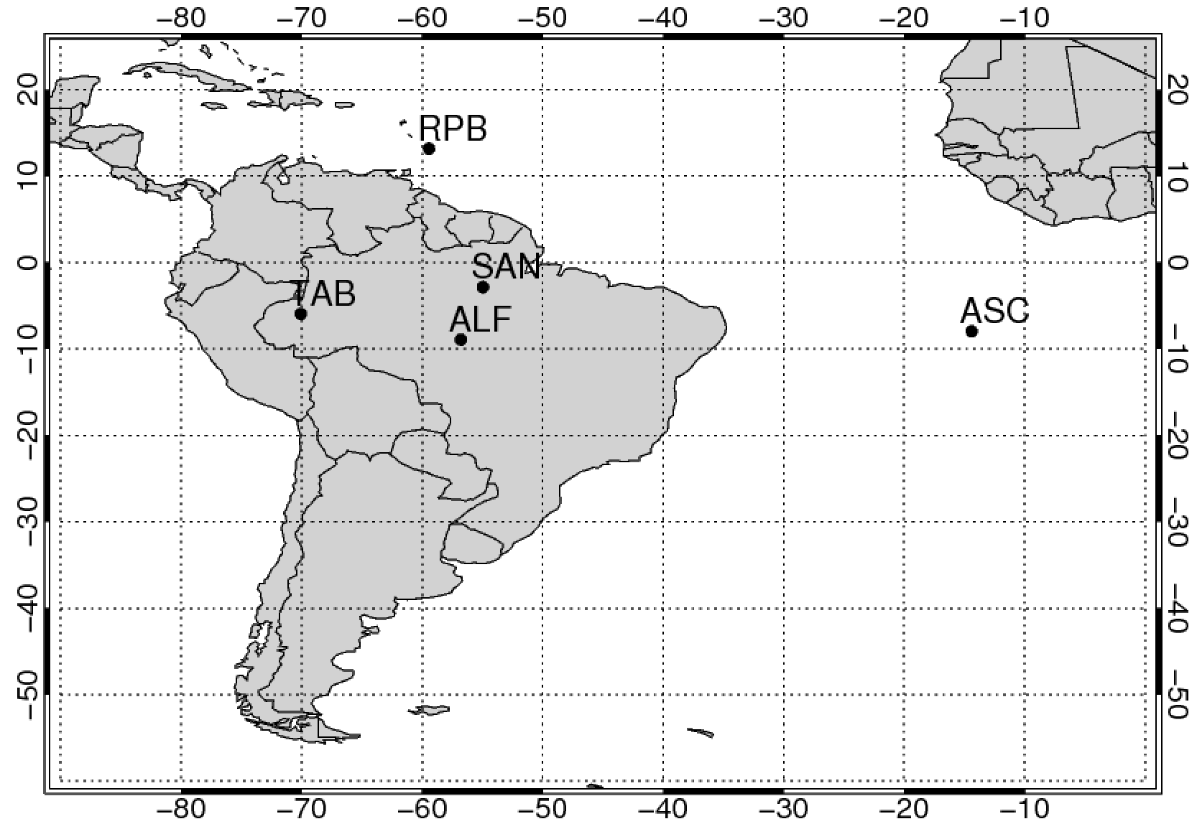
Domain and Observation Sites:
(prevailing
wind)
RBA
(prevailing
wind)
4 Sites over Amazon Basin
Flights every 2-3 weeks
10-20 Samples Each Flight
from ~300 m to 4400 m
2 “boundary” sites
Weekly Sampling

Slide 18
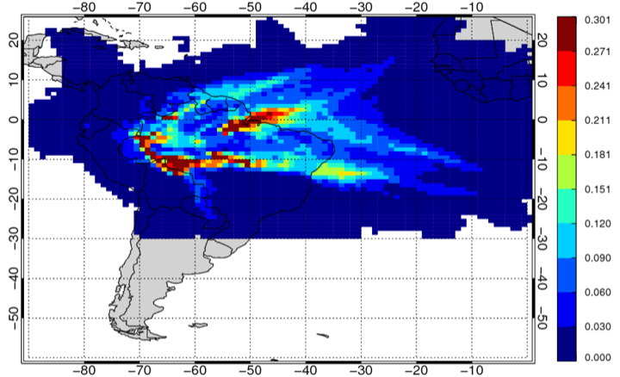
Lagrangian Particle Dispersion Modeling:
By running imaginary particles backwards through time (using known meteorology) we can determine the influence (footprints) of surface fluxes on measurements.
ppm / (μmol m⁻² s⁻¹)
I’ll show results from 2 Lagrangian Particle Dispersion Models:
FLEXPART with GFS meteorology
HYSPLIT with NAMS meteorology
Notes:
Here you see an example of the combined footprints for the four sites shown on slide 2.

Slide 19
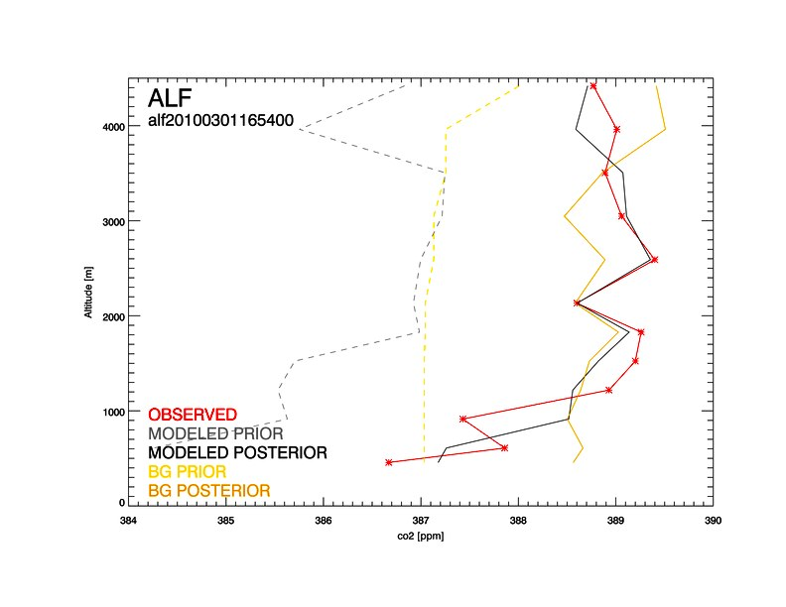
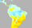
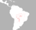
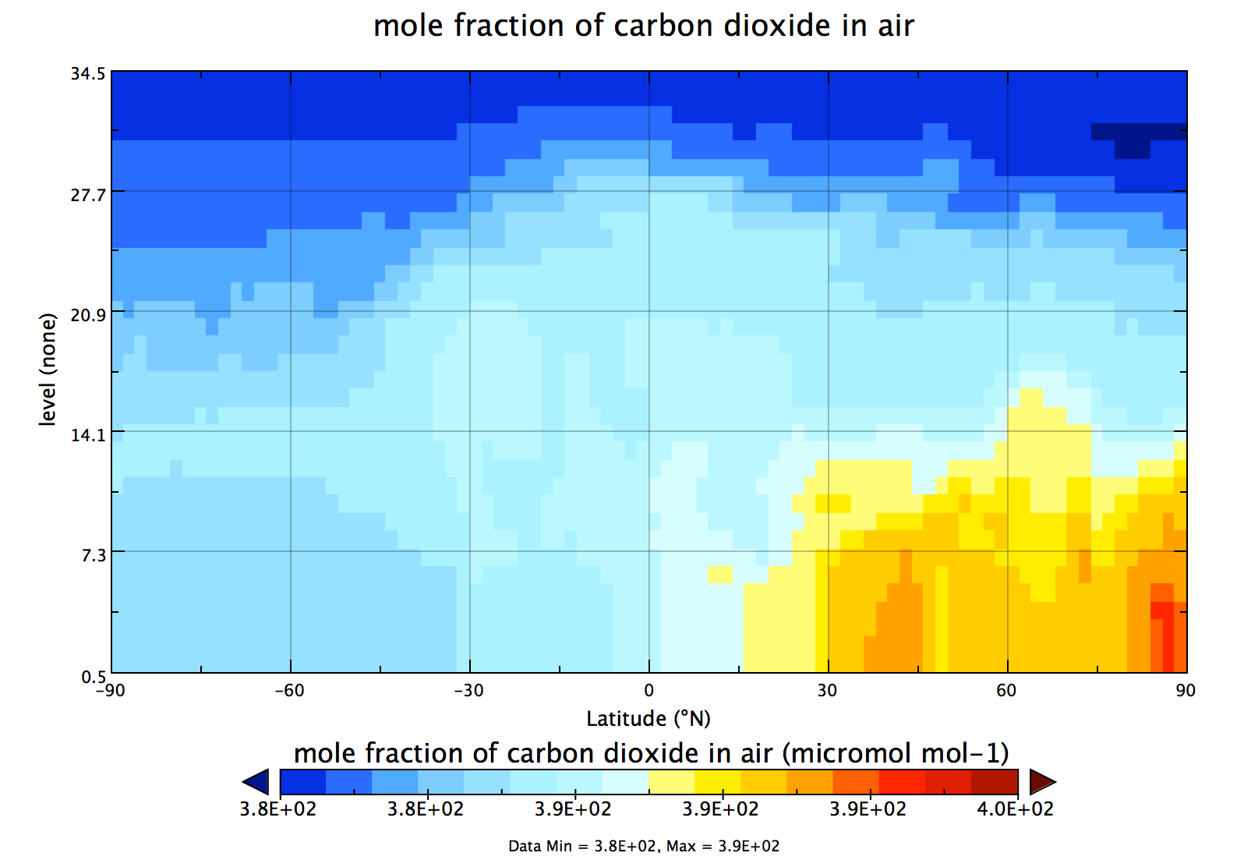
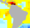
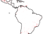
Regional Inverse Modeling
Use observations to optimize first-guess (a priori) biosphere fluxes
CO2_pred = Flux X Footprint + CO2_bg
=
X
+
20N
20S
Prediction
Prior Flux
Footprint
Background
ΔCO2 = CO2_obs - CO2_pred
→ The inversion adjusts fluxes (and background) to minimize ΔCO2

Slide 20
CO2 INVERSION FRAMEWORK
1 year batch inversions, covering 2010-2011
~1000 Observations/year from 4 sites: ALF, RBA, SAN, TAB
Flux vector includes: (Covariance Matrix ~ 10^14 elements!!)
  1) Land Biosphere Fluxes (NEE) + Fire Fluxes
  2) Background mole fractions (background will be optimized!)
Inversion resolution: 3-hourly, 1ºx1º
Aggregate fluxes to sub-Basin regions by month

Slide 21
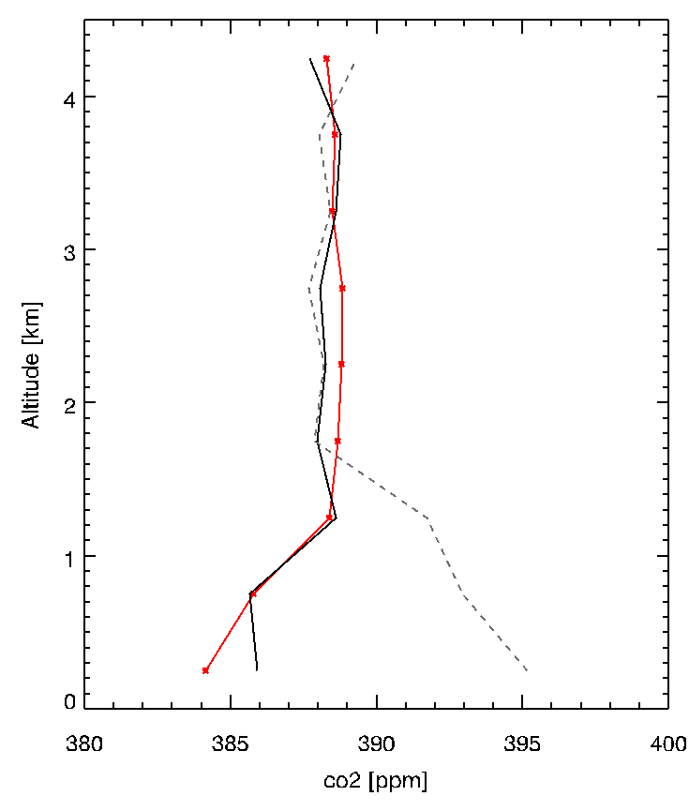
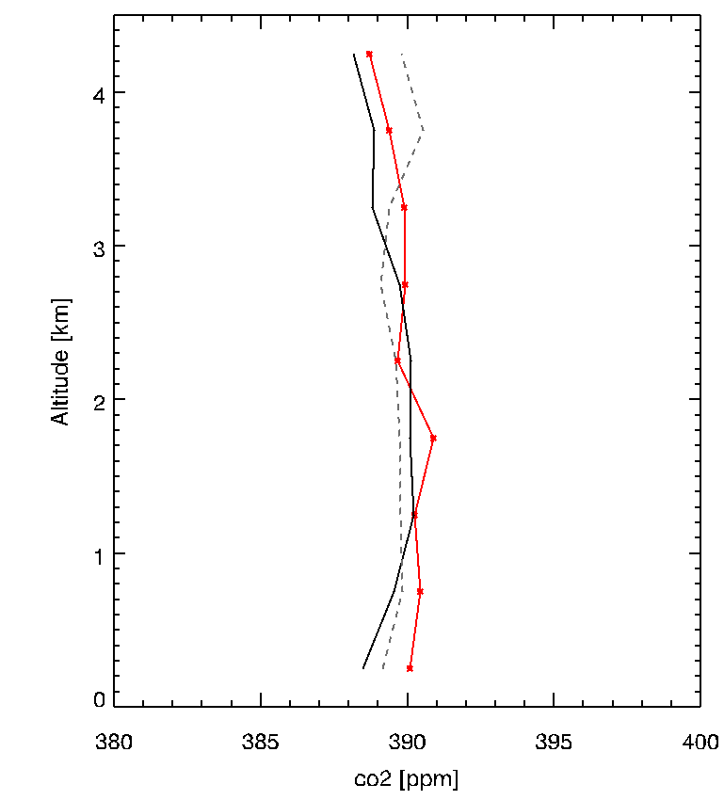
RBA 2010 Wet Season (jan-may)
* Observations
-- Prior Estimate
– Posterior Estimate
RBA 2010 Dry Season (july-oct)
* Observations
-- Prior Estimate
– Posterior Estimate

Slide 22
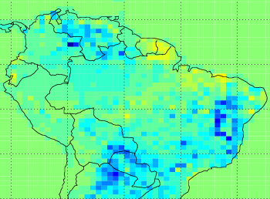
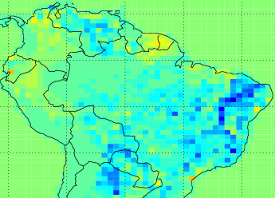
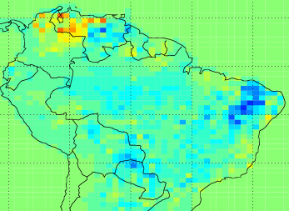
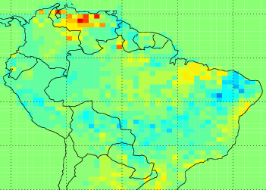
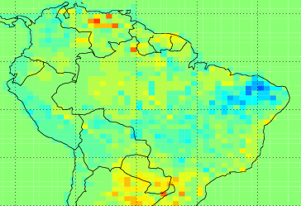
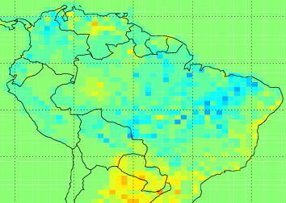
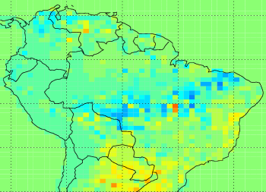
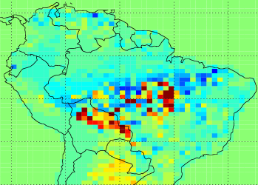
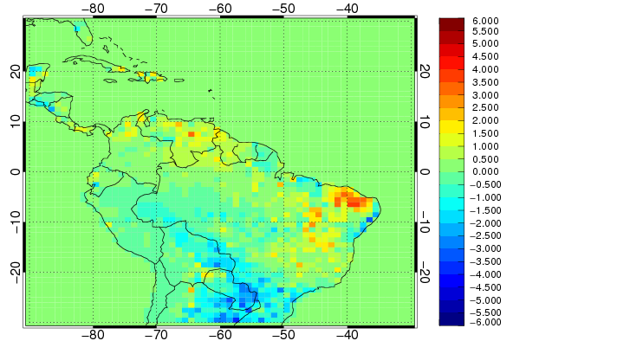
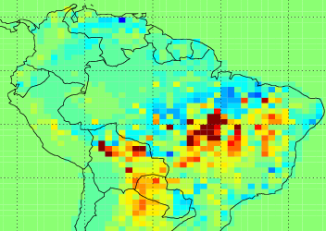
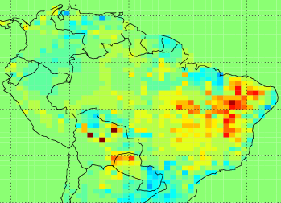
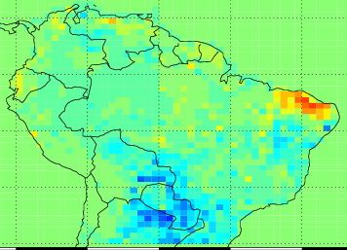
Monthly Mean Fluxes 2010 (Transport from Hysplit)
Jan 2010
Feb 2010
Mar 2010
Apr 2010
May 2010
Jun 2010
Jul 2010
Aug 2010
Sep 2010
Oct 2010
Nov 2010
Dec 2010
umol C /m2 /s
Notes:
--no bulls eyes obvious.
-- a lot of adjustment outside the Basin
--

Slide 23
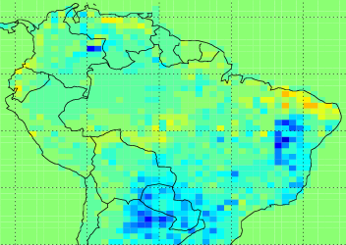
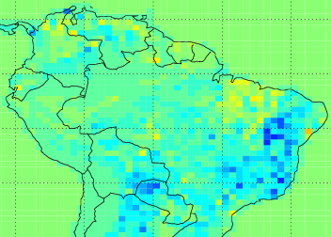
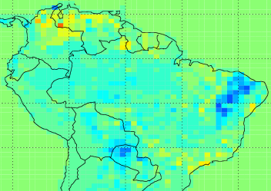
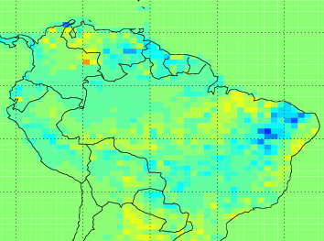
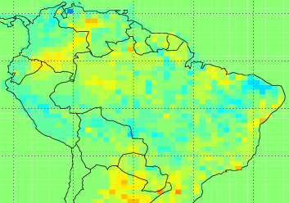
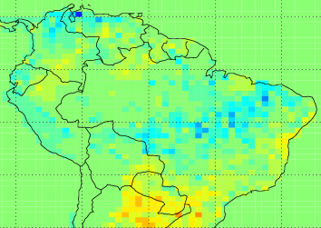
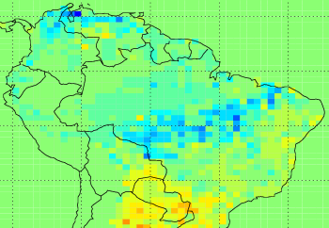
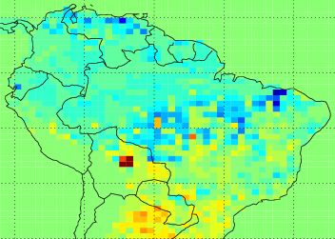
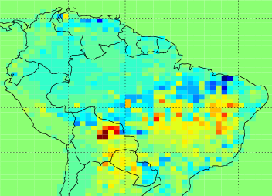
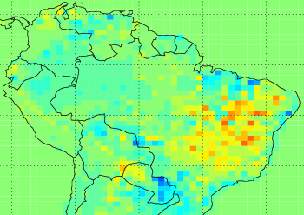
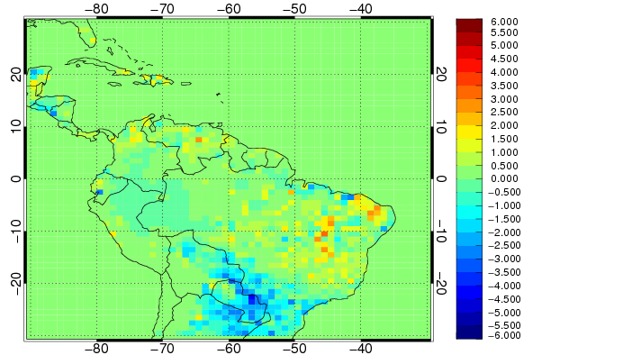
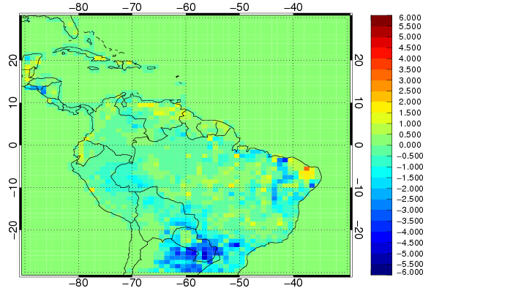
Monthly Mean Fluxes 2011 (Transport from Hysplit)
Jan 2011
Feb 2011
Mar 2011
Apr 2011
May 2011
Jun 2011
Jul 2011
Aug 2011
Sep 2011
Oct 2011
Nov 2011
Dec 2011
umol C /m2 /s

Slide 24
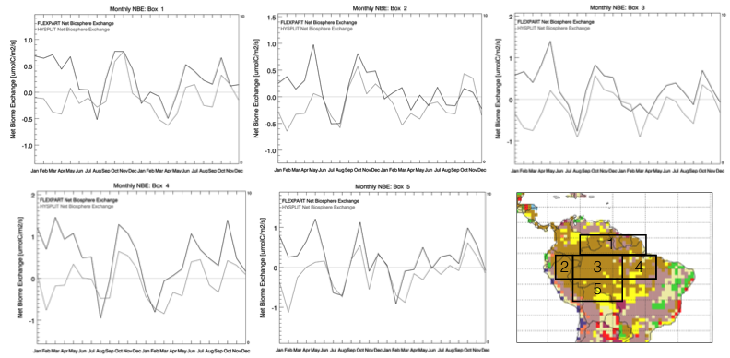
Aggregated Basin Flux Totals by Month: 2010 and 2011
2010
2011
2010
2011

Slide 25
Basinwide Flux Totals
Total C Flux (NBE + Fire) [PgC/yr]
 | 2010 | 2011 | Difference
HYSPLIT | 0.07+/-0.38 | -0.34+/-0.32 | 0.41
FLEXPART | 1.05+/-0.40 | 0.35+/-0.35 | 0.70
Gatti, 2014, Nature | 0.48+/-0.18 | 0.06+/-0.10 | 0.42 +/- 0.2

Slide 26
To Be Done…
Regional CO Inversions ☑ (not shown here)
Sub-basin and Seasonal Aggregation
2012-2013 Inversions (2014 Project)
Use BRAMS/STILT Footprints for 2010-2011
Compare results with CMS Flux product

Slide 27
CO Inversion Setup
Global CO inversion using TM5 with S. American zoom region.
Prior fire flux from GFED3.1 with diurnal cycle and climatological injection heights.
Fluxes from CH4 and VOC oxidation and OH sink included, but not optimized.
Adjustments are weekly at the grid (1x1) scale.
Data inputs are combinations of:
  Aircraft CO profiles
  NOAA background data
  IASI

Slide 28
CO Inversion Results - 2010

Slide 29
CO Inversion Results - 2011

Slide 30

CO Inversion Results: 2010 – 2011
Basinwide Fire Flux for CO2
Gatti, 2014
Assume 75 ppb/ppm fire emission ratio

